Slide 1
Pointers

Slide 2
Pointer Basics
A pointer is a variable that holds the memory address of another object.
If a variable called p contains the address of another variable called q, then p is said to point to q.
Then if q is at location 100 (say) in memory, then p would have the value 100.

Slide 3
Variable and Memory Add.
char q;
Variable
RAM
Value
Value
int a;
1024
A
q
unknown
q = ‘A’;
1025
108
unknown
a
Unknown
1026
unknown
a = 108;
1027
unknown
1028
unknown
1029
unknown

Slide 4
How to declare?
General form:
Here, type is the base type of the pointer
It specifies the type of the object that the pointer can point to.
The asterisk (*) tells the computer that a pointer variable is being created.
Example:
type *var-name;
int *p;

Slide 5
Variable and Memory Add.
char q;
Variable
RAM
Value
Value
char *p;
1024
A
q
unknown
q = ‘A’;
p
1025
unknown
1024
1026
unknown
Want, p to point q
1027
unknown
1028
unknown
1029
unknown

Slide 6
Special Pointer Operator
C contain two special pointer operator
* and &
The & operator return the address of the variable it precedes.
We can verbalize as address of
The * operator returns the value stored at the address that it precedes.
We can verbalize as at address

Slide 7
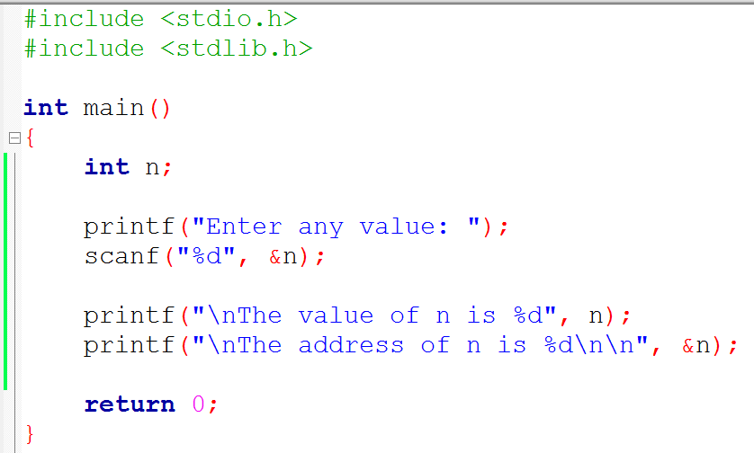
Pointer - & operator

Slide 8
Variable and Memory Add.
char q;
Variable
RAM
Value
Value
Char *p;
1024
A
q
unknown
q = ‘A’;
p
1025
unknown
1024
P = &q;
1026
unknown
1027
unknown
1028
unknown
1029
unknown

Slide 9
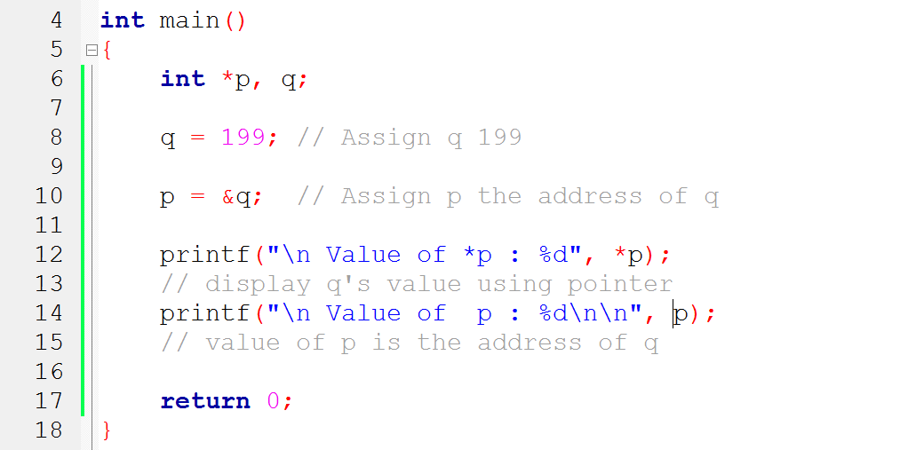
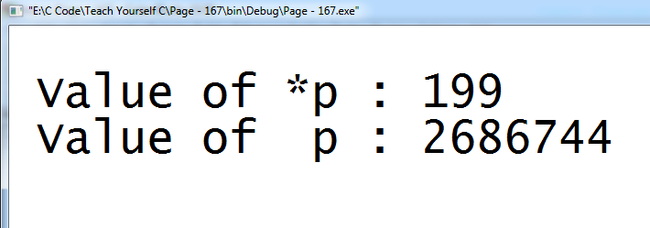
Example 1
We can verbalize & as address of
We can verbalize * as at address
Defines two variable: p integer pointer and q is integer
Assign q the value 199
Assign p the address of q
Print the value at address q
Print the value of p (it holding the address of q)

Slide 10
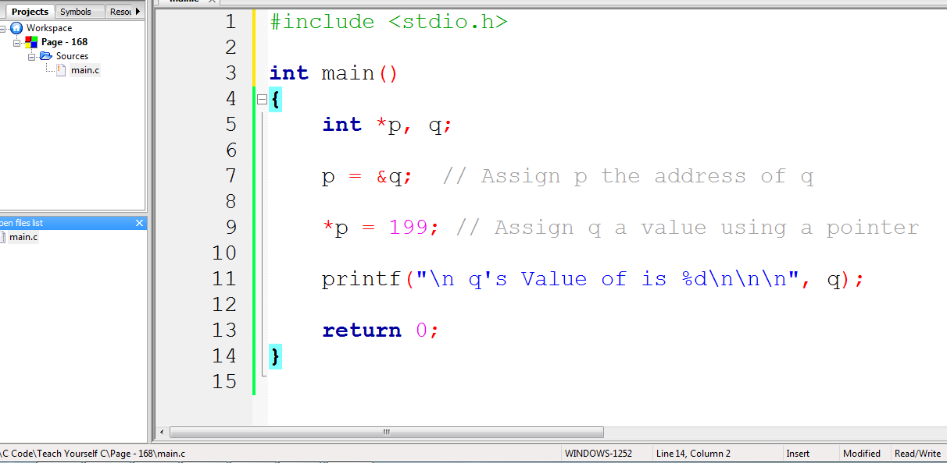
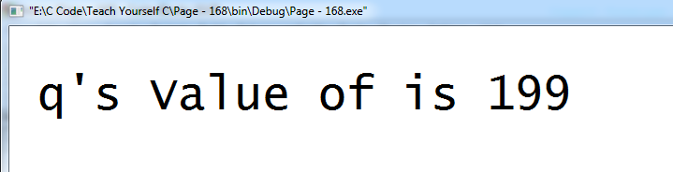
Example 2

Slide 11
Indirection
When a variable’s value is referenced through a pointer, the process is called indirection.
Location | Contents
100 (p) | Unknown
104 (q) | Unknown
int *p, q;
Location | Contents
100 (p) | 104
104 (q) | Unknown
p = &q;
p points to q
Location | Contents
100 (p) | 104
104 (q) | 199
*p = 199;
p points to q

Slide 12
Importance
Pointers provide direct access to memory
Pointers provide a way to return more than one value to the functions
Reduces the storage space and complexity of the program
Reduces the execution time of the program
Provides an alternate way to access array elements
Pointers can be used to pass information back and forth between the calling function and called function.
Pointers helps us to build complex data structures like linked list, stack, queues, trees, graphs etc.
Addresses of objects can be extracted using pointers

Slide 13
Base type of a Pointer
The base type of a pointer is very important.
Though C allow any type of pointer to point anywhere in memory, but the base type determine how the object pointed to will be treated.
The C compiler uses the base type to determine how many bytes are in the object pointed to by the pointer.
This is how the compiler know how many bytes to copy when an indirection assignment is made

Slide 14
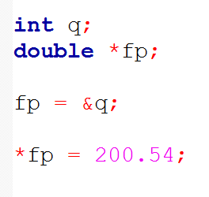
Base type of a Pointer …
Consider this fragment:
not syntactically incorrect
but wrong
fp assign address of an integer
this address try hold floating point value
ints are shorter than doubles

Slide 15
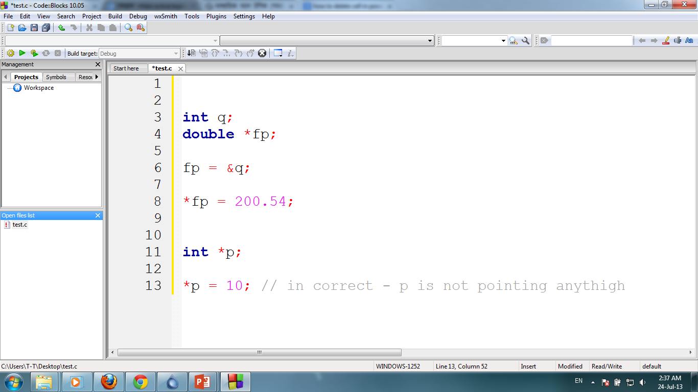
Pointer…
If we attempt to use a pointer before it has been assign the address of a variable - our program probably crash.

Slide 16
Pointer…
A pointer that contains a null value (zero) is assumed to be unused and pointing at nothing.
In C, a null is assumed to be an invalid memory address.

Slide 17
Restrictions to Pointer
In addition to “*” and “&” operators, it supports only four other operators-
We only can add or subtract integer quantities.
+
++
-
--

Slide 18
Pointer Arithmetic
Pointer arithmetic differs from “normal” arithmetic.
It is performed relative to the base type

Slide 19
Pointer Arithmetic
Variable
RAM
Value
char *p;
p
1024
1025
char q;
q
1025
unknown
p = &q;
1026
unknown
p++;
1027
unknown
1028
unknown
p = ?;

Slide 20
Pointer Arithmetic
Variable
RAM
Value
int *p;
p
1024
1028
int q;
q
1028
unknown
p = &q;
p++;
p = ?;

Slide 21
Pointer Arithmetic
Variable
RAM
Value
int *p;
p
1024
1028
int q;
q
1028
unknown
p = &q;
P = p + 200;
p = ?;

Slide 22
Pointer Arithmetic
Variable
RAM
Value
int *p;
p
1024
1028
int q=10, r=100;
q
1028
10
p = &q;
r
1032
100
*p++;
(*p)++;

Slide 23
*p++ vs ++*p vs *++p
Precedence of prefix ++ and * is same. Associativity of both is right to left.
Precedence of postfix ++ is higher than both * and prefix ++. Associativity of postfix ++ is left to right.

Slide 24
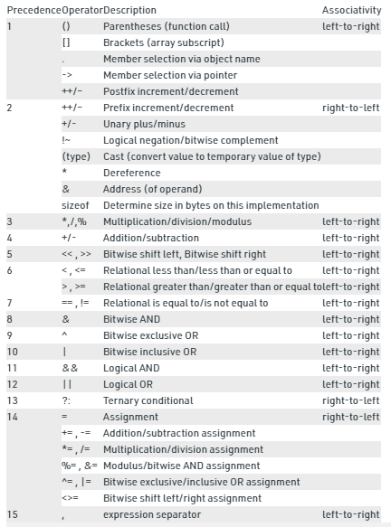
Operator precedence

Slide 25
*p++ vs ++*p vs *++p
The expression ++*p has two operators of same precedence, so compiler looks for associativity. Associativity of operators is right to left. Therefore the expression is treated as ++(*p).
The expression *p++ is treated as *(p++) as the precedence of postfix ++ is higher than *.
The expression *++p has two operators of same precedence, so compiler looks for associativity. Associativity of operators is right to left. Therefore the expression is treated as *(++p).

Slide 26
Use Array with Pointer
In C, pointers and arrays are closely related.
They are often interchangeable
This relationship between the two makes their implementation both unique and powerful

Slide 27
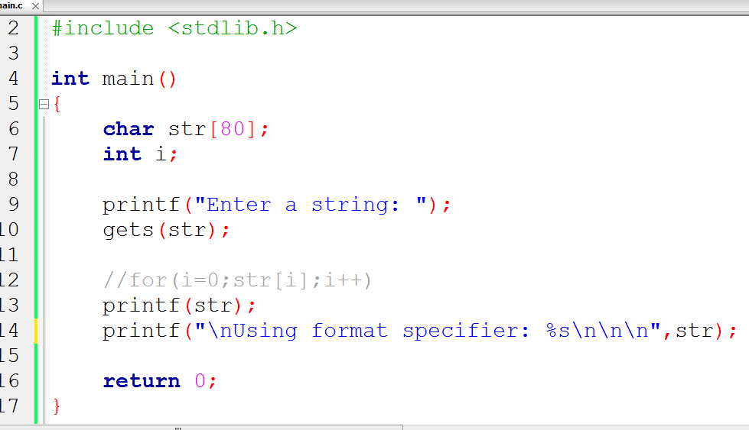
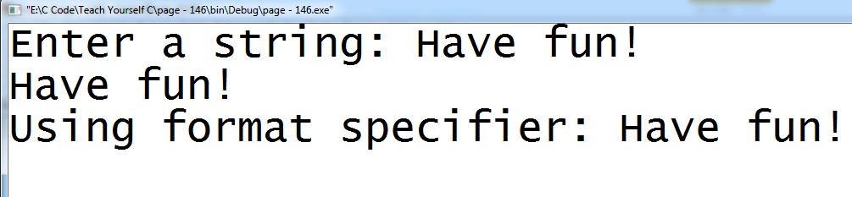
Use Array with Pointer…
Here what is being passed to gets() is not an array but pointer
Actually we can’t pass an array to a function in C we only pass a pointer
The gets() function uses the pointer to load the array it points to with the characters we enter at the keyboard (will see later)
When we use an array name without an index, we are generating a pointer to the start of the array.
gets();

Slide 28
Use Array with Pointer…
Since the array name without an index is a pointer to the start of the array.
it is possible to assign that value to another pointer and access the array using pointer arithmetic.
Multidimensional array?

Slide 29
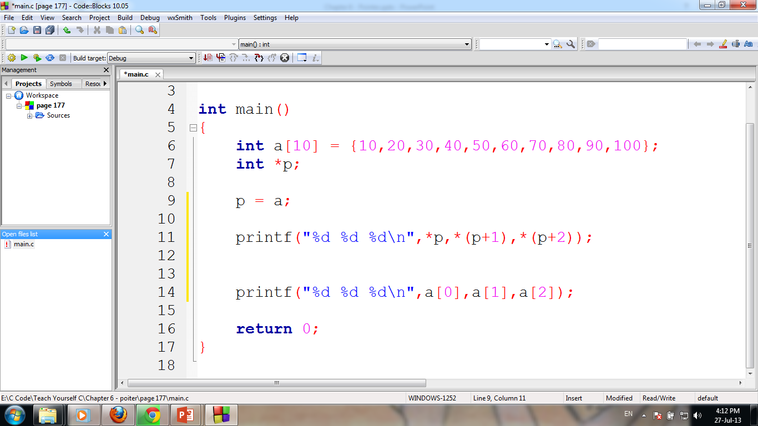
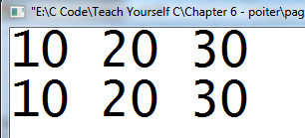
Assign p the address of start of a
Similar as p = &q
This print the first, second and third elements of array a
Print these element using array index

Slide 30
Why?
Here the parentheses in expressions such as *(p+1) are necessary because the * has higher precedence than the + operator

Slide 31
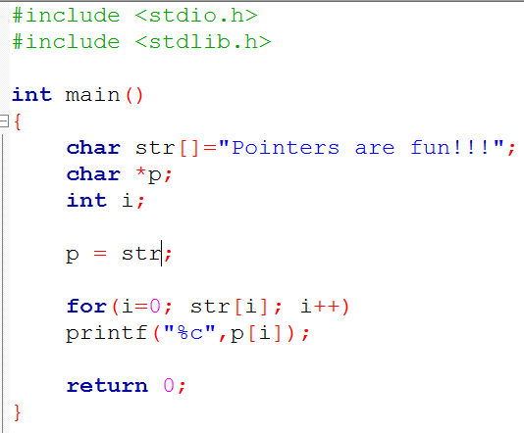
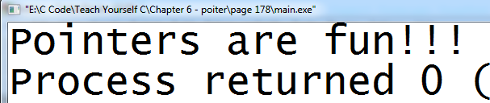
Pointer as Array!!!
We can index a pointer as if it were an array
Keep one point firmly in your mind:
We should index a pointer only when that pointer points to an array.

Slide 32
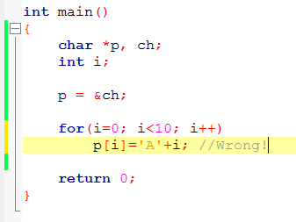
We should index a pointer only when that pointer points to an array.
Consider the following fragment-
Wrong: Since ch is not an array. It can't meaningfully indexed.

Slide 33
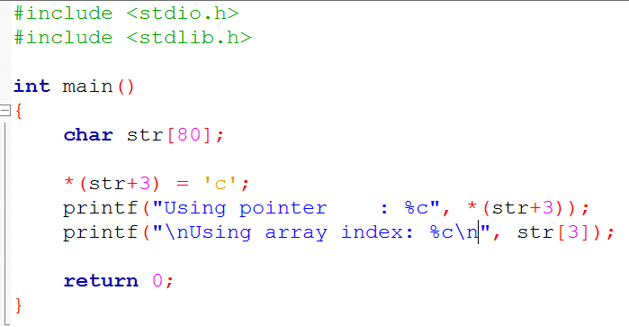
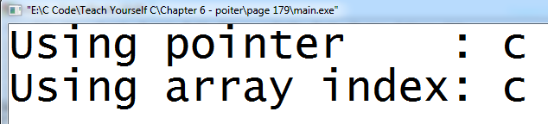
We can use pointer arithmetic rather than array indexing to access elements to the array.
Remember! We can’t modify the value of the pointer generated by using an array name.
In this example str++ is wrong.

Slide 34
Array index or Pointer arithmetic?
In some case C compiler can generate faster executable code for an expression involving pointers than for a comparable expression array.

Slide 35
Use pointer with String
C allows string constants enclosed between double quotes to be used in a program.
Here the compiler store it in program’s string table and generates a pointer to the string.

Slide 36
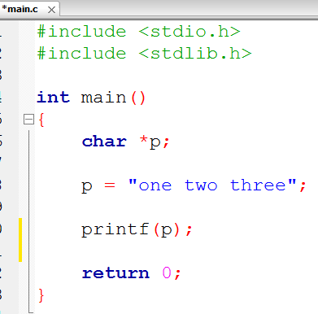
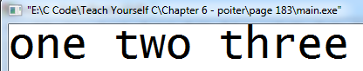
Use pointer with String…
Here we declare a character pointer p.
This means that it may point to an array of characters.
It store the string in the program’s string table and assigns to p the address of the string table.

Slide 37
Create arrays of pointer
int *p[2], q, z;
int p[0] = &q;
int p[1] = &z;

Slide 38
Multiple indirection
When a pointer point to another pointer, it is called multiple indirection.
When a pointer points to another pointer, the first pointer contain the address of the second pointer, which is containing the location of the object.
To declare a pointer to a pointer, an additional asterisk is placed in front of the pointers name – char **mp;

Slide 39

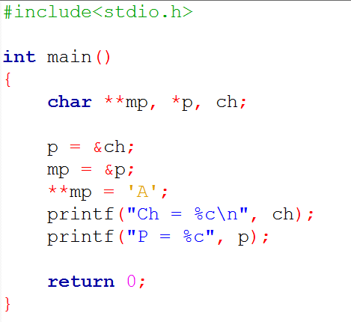
Multiple indirection

